Slide 1


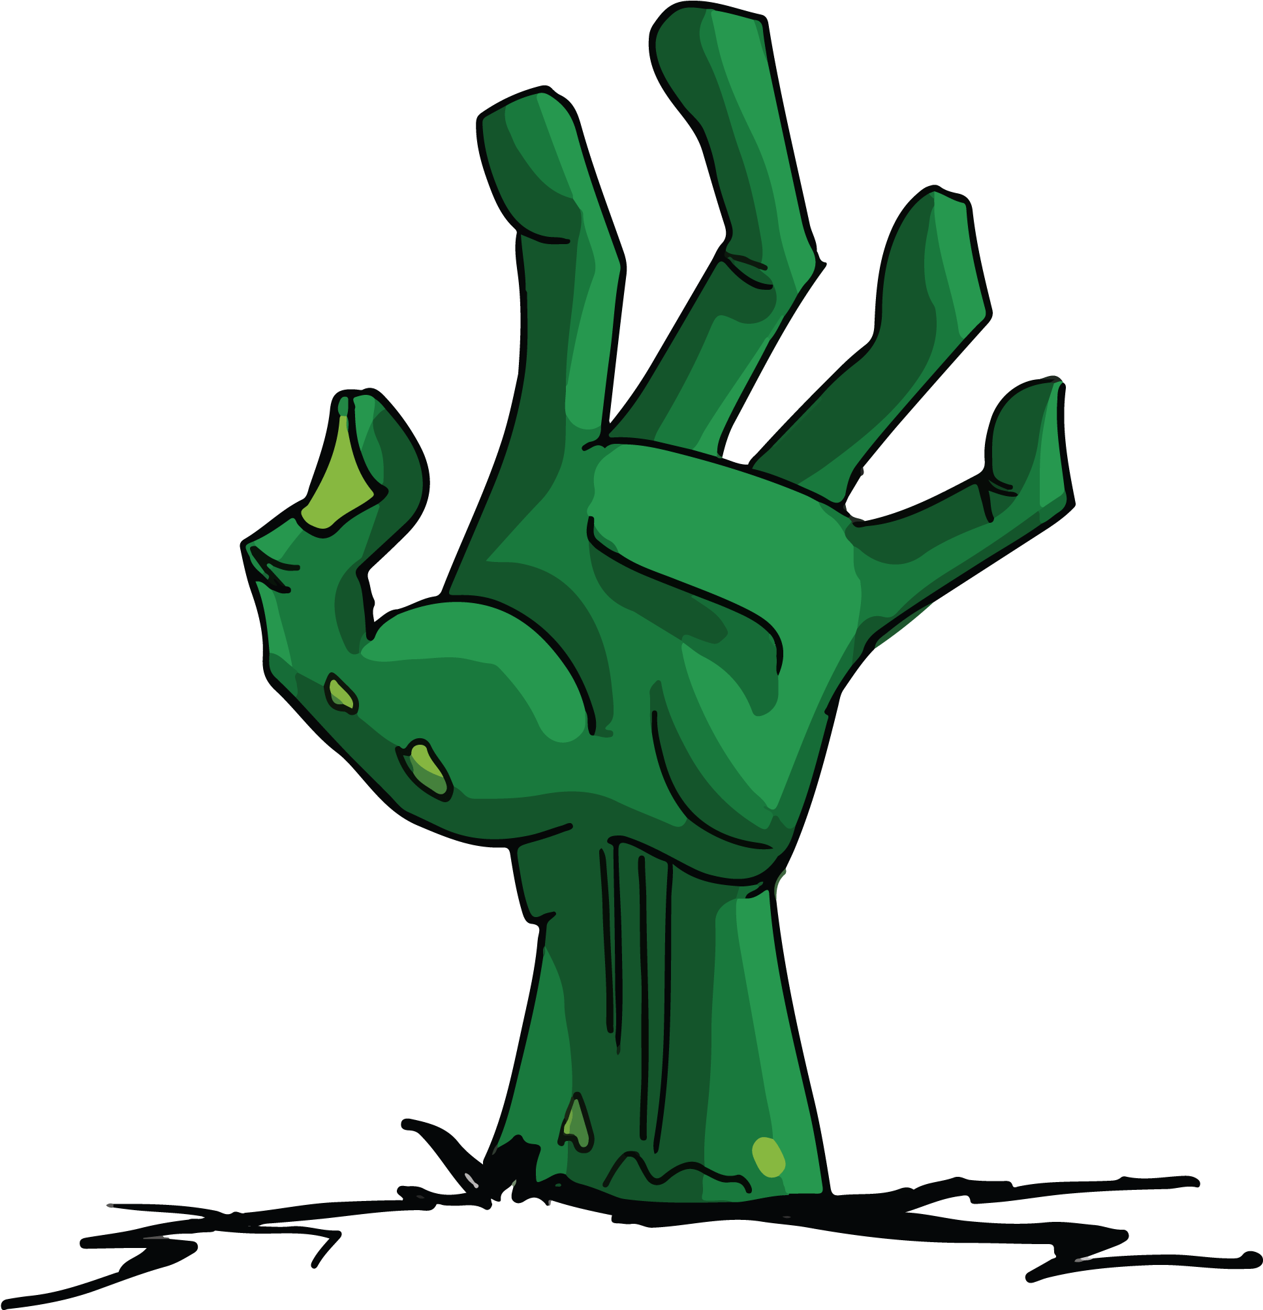

Necro Nursery
Team Abra-cadaver

Slide 2

Narrative
Wrote dialogue for mentor and merchant.
Wrote presentable world bible and High concept for Nanocon.

Slide 3

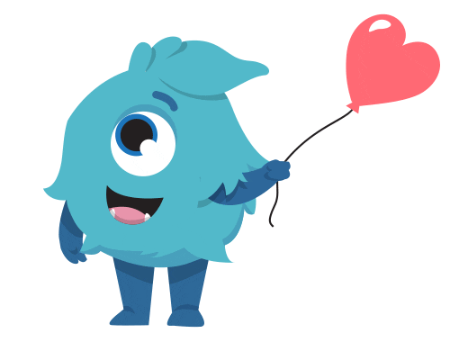
Audio
Created version 1 of new minigame music soundtracks
Concepts of sounds for future soul minigame soundtrack(s)

Slide 4

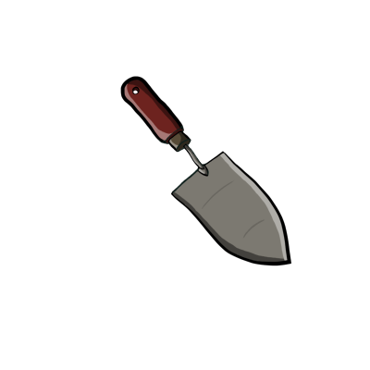


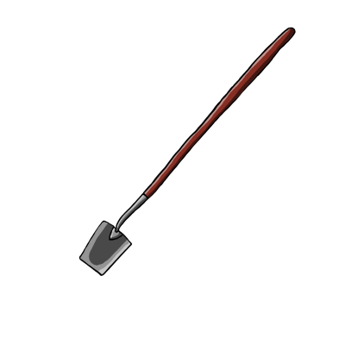
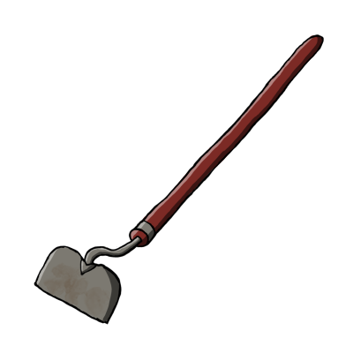

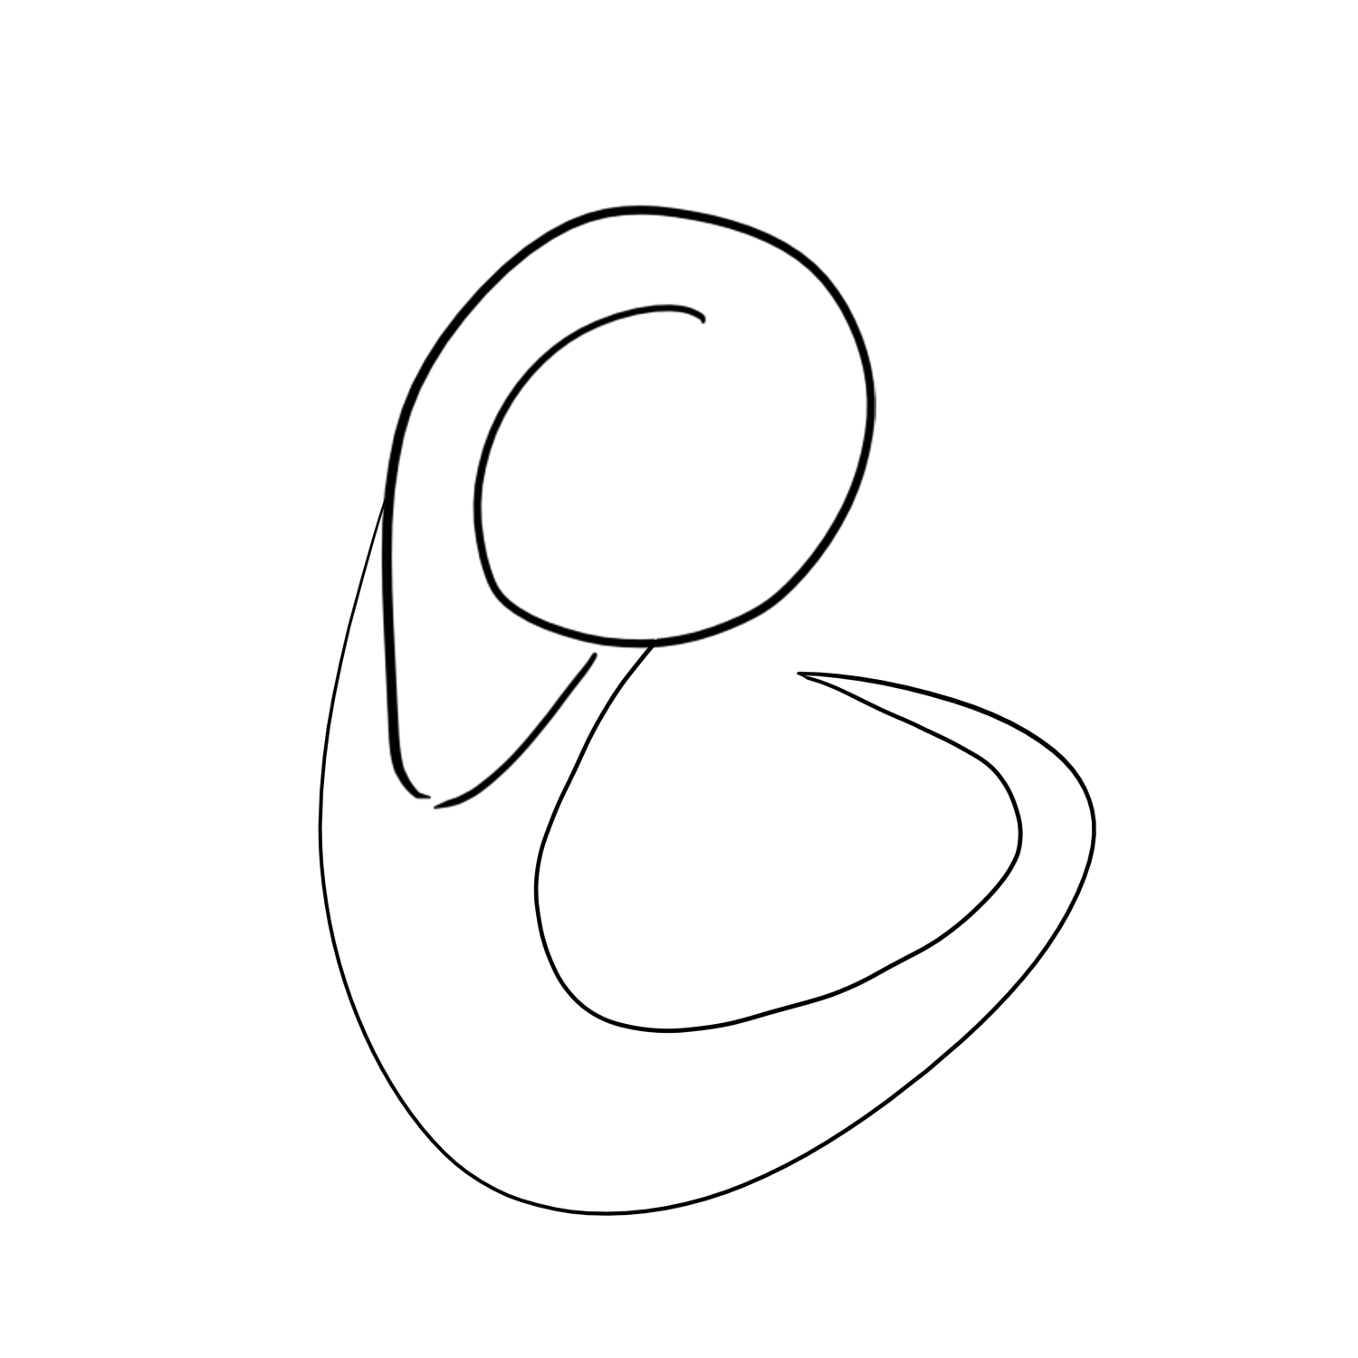

Slide 5
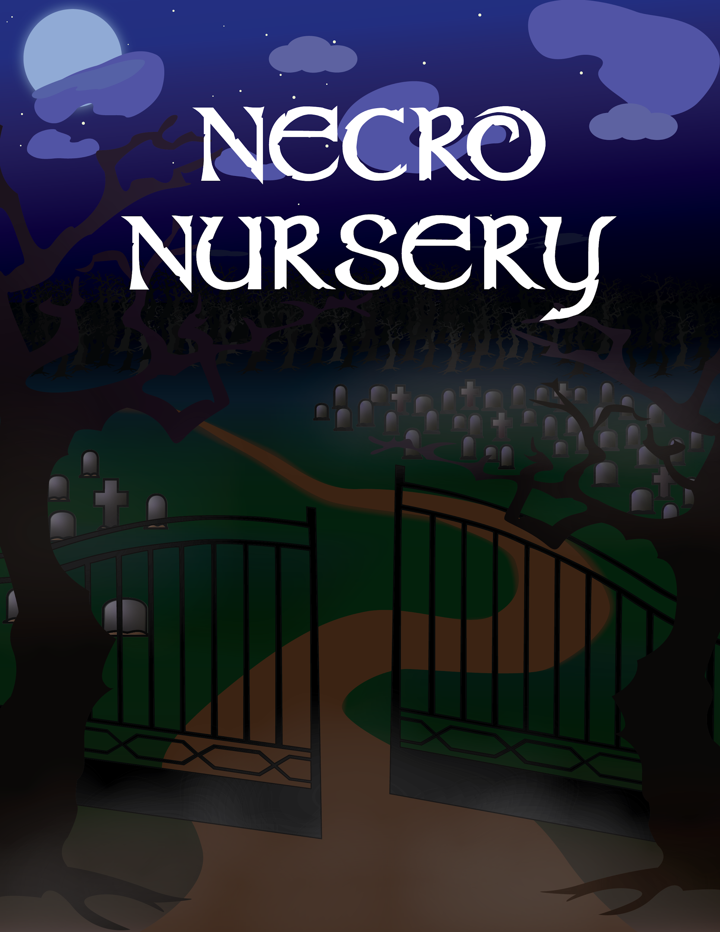

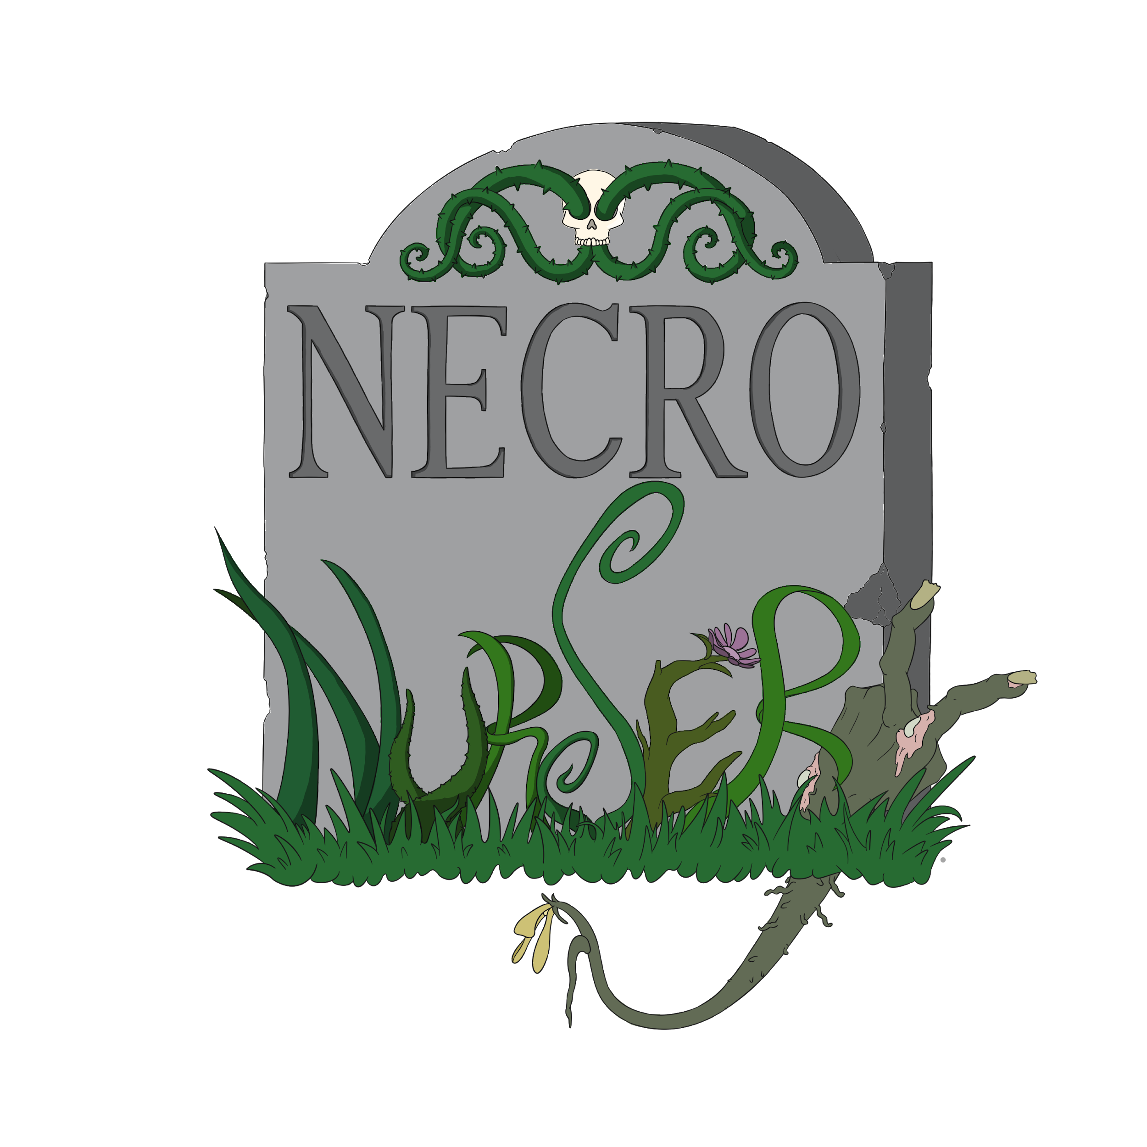
(Still in progress)
10 WBs spent on this, don’t know how to color it :(
(thank you Brooke and Jack)

Slide 6
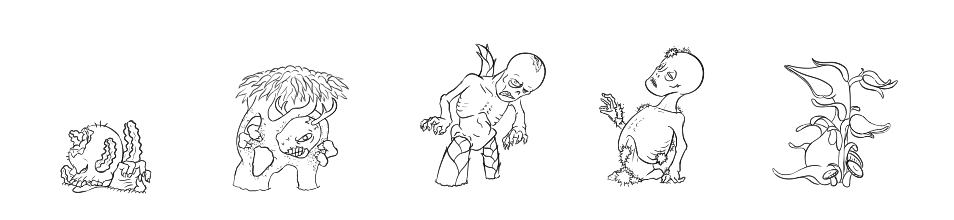
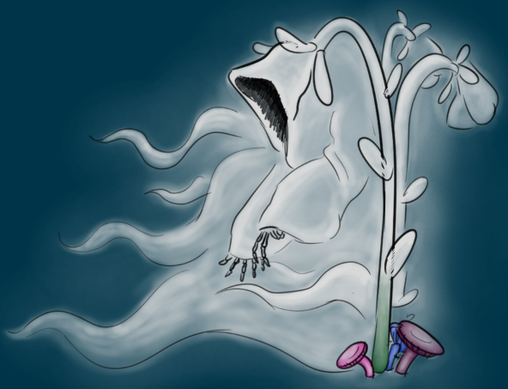
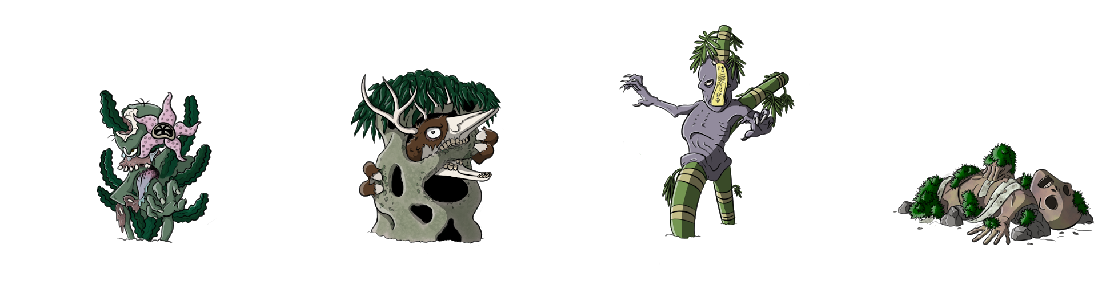

Slide 7

Programming
Loading is now less destructive
Added tutorial scene when first opening the app
Mastermind Minigame started
Brewing Minigame started
Added Dialogue to Tutorial and Market Scenes

Slide 8
Playtesting
Nanocon
Lots of bugs
Overall reception was good
Found a few new bugs, nothing overly major
Started playtesting new mastermind minigame
Paper prototyped
Trying to figure out how to put our own spin on it

Slide 9
Troubles along the way?
Lots of bugs discovered before Nanocon but the game breaking one's got fixed.
Need to playtest heavily again to find any new or persisting bugs.

Slide 10
What we plan to do!
Clean up tutorial
Finish up minigames
Finalize lore on minigames

Slide 11
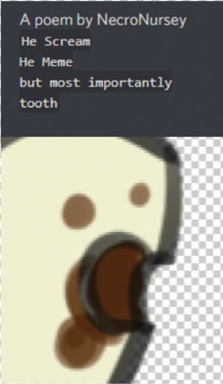
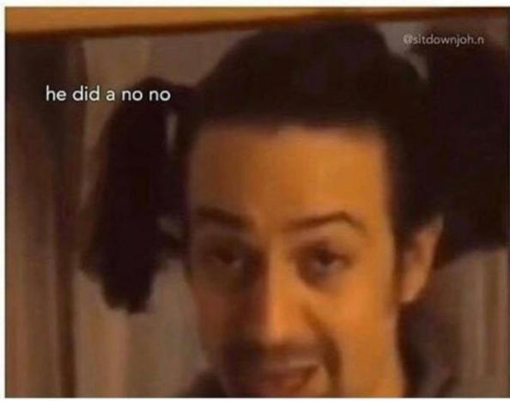
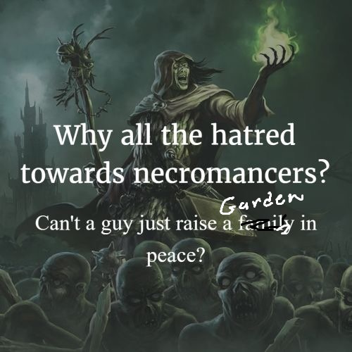
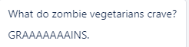
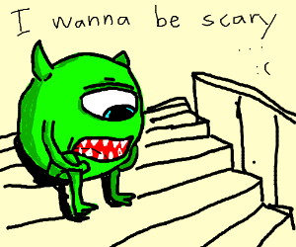
Questions?

